Slide 1
Deep Dive of the SharePoint Framework
Tour of the web part project

Slide 2
Agenda
Files, Folders, and Configuration
Manifest
Q&A

Slide 3
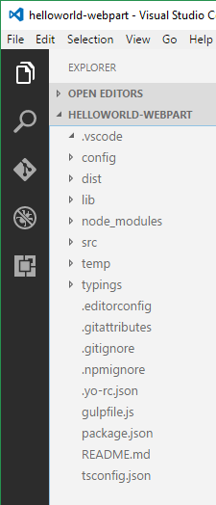
Project Structure
Top level folders
.vscode: includes Visual Studio Code integration files
config: includes all config files
dist: created automatically when you build the project – holds debug builds
lib: created automatically when you build the project
node_modules: this is created automatically when you build your project, it includes all the npm packages your solution relies upon and their dependencies
src: this is the main folder of the project, it includes the web part, styles, and a test file
temp: created automatically when you build your project – holds production builds
typings: includes some type definition files. Most type definitions are installed in node_modules\@types

Slide 4
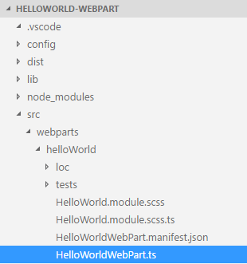
Key Files – web part class
Defines the main entry point for the web part
Extends the BaseClientSideWebPart.
All client-side webs part must extend the BaseClientSideWebPart class in order to be defined as a valid web part
import { IHelloWorldWebPartProps } from './IHelloWorldWebPartProps';
export default class HelloWorldWebPart extends BaseClientSideWebPart<IHelloWorldWebPartProps>
{
// code omitted
}
Notes:
BaseClientSideWebPart implements the minimal functionality that is required to build a web part. This class also provides many parameters to validate and access to read-only properties such as displayMode, web part properties, web part context, the web part instanceId, the web part domElement and much more.
Notice that the web part class is defined to accept a property type IHelloWorldWebPartProps.
The property type is defined as an interface in a separate file IHelloWorldWebPartProps.ts.
export interface IHelloWorldWebPartProps { description: string; }

Slide 5
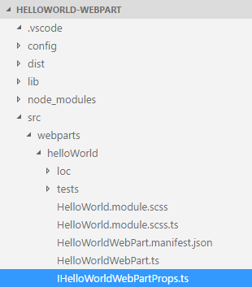
Key Files – web part properties class
Defines the interface for moving properties between different classes in the web part
export interface IHelloWorldWebPartProps {
description: string;
}

Slide 6
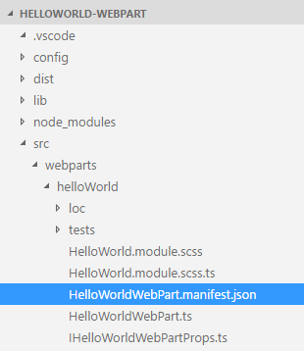
Key Files – web part manifest
Defines the web part metadata
{
"$schema": "../../../node_modules/@microsoft/sp-module-interfaces/lib/manifestSchemas/jsonSchemas/clientSideComponentManifestSchema.json",
"id": "318dd20d-0c02-4c3d-acc5-e2c0fa84cf3f",
"alias": "HelloWorldWebPart",
"componentType": "WebPart",
"version": "0.0.1",
"manifestVersion": 2,
"preconfiguredEntries": [{
"groupId": "318dd20d-0c02-4c3d-acc5-e2c0fa84cf3f",
"group": { "default": "Under Development" },
"title": { "default": "HelloWorld" },
"description": { "default": "HelloWorld description" },
"officeFabricIconFontName": "Page",
"properties": {
"description": "HelloWorld"
}
}]
}
Notes:
Defines the web part metadata such as version, id, componentType, manifestVersion, and description. Every web part must contain this manifest.

Slide 7
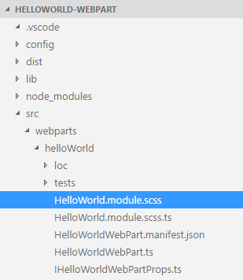
Key Files – SCSS file
Defines the web part styles
.container {
max-width: 700px;
margin: 0px auto;
box-shadow: 0 2px 4px 0 rgba(0, 0, 0, 0.2), 0 25px 50px 0 rgba(0, 0, 0, 0.1);
}
.row {
padding: 20px;
}
.listItem {
max-width: 715px;
margin: 5px auto 5px auto;
box-shadow: 0 0 4px 0 rgba(0, 0, 0, 0.2), 0 25px 50px 0 rgba(0, 0, 0, 0.1);
}

Slide 8
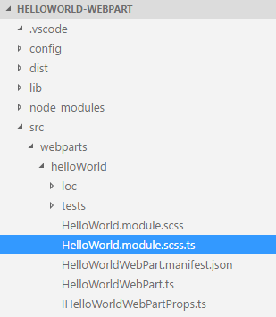
Key Files – SCSS TypeScript file
Defines the TypeScript typings for the web part styles
/* tslint:disable */
require('./HelloWorld.module.css');
const styles = {
helloWorld: 'helloWorld_68b3b0f6',
container: 'container_68b3b0f6',
row: 'row_68b3b0f6',
listItem: 'listItem_68b3b0f6',
button: 'button_68b3b0f6',
label: 'label_68b3b0f6',
};
export default styles;
/* tslint:enable */
Notes:
HelloWorld.module.scss.ts is the typescript file that includes the corresponding typings of HelloWorld.module.scss, you can then import and reference these styles in your web part code.

Slide 9
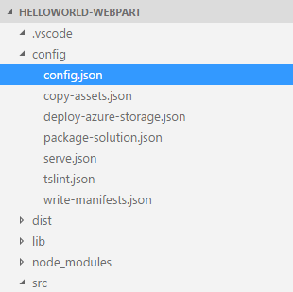
Key Files – config file
Contains information about your bundle(s), any external dependencies, localized resources
Specifies the AMD script libraries used in the web part
{
"entries": [
{
"entry": "./lib/webparts/helloWorld/HelloWorldWebPart.js",
"manifest": "./src/webparts/helloWorld/HelloWorldWebPart.manifest.json",
"outputPath": "./dist/hello-world.bundle.js"
}
],
"externals": {
“jquery": "node_modules/jquery/dist/jquery.min.js"
},
"localizedResources": {
"helloWorldStrings": "webparts/helloWorld/loc/{locale}.js"
}
}
Notes:
This file contains information about your bundle(s) and any external dependencies and localized resources.
- The entries section contains the default bundle information.
- The externals section contains the libraries that are not bundled with the default bundle.

Slide 10
DEMO
Tour of the web part project
Notes:
Use the Tour of the web part project exercise in the lab manual.

Slide 11
Summary
Files, Folders, and Configuration
Manifest
Q&A

Slide 12

Sharing is caring…
Code samples and solutions
Reusable components
Guidance documentation
Monthly community calls
SharePoint Framework
SharePoint add-ins
Microsoft Graph
Office 365 APIs
http://aka.ms/SharePointPnP

Slide 13

Q&A

Slide 14


